Slide 1

DABN14-Project 1: Credit on balance
12.12.25
Predicting credit card fraud on an imbalanced dataset
Erik Broms & William Nordansjö

Slide 2
Agenda
DABN14-Project 1
1.
Introduction, Data & Research Question
2.
Imbalanced Data
3.
Models & Theory
4.
Results
5.
Conclusion

Slide 3
Agenda
DABN14-Project 1
1.
Introduction, Data & Research Question
2.
Imbalanced Data
3.
Models & Theory
4.
Results
5.
Conclusion

Slide 4
Introduction, Data & Research Question
DABN14-Project 1
“Fraud is the category of crime that has increased the most in 2023 according to the Swedish National Council for crime prevention.”

Slide 5
Introduction, Data & Research Question
DABN14-Project 1
Credit Card Fraud Detection - Machine Learning Group of ULB (Université Libre de Bruxelles)
284,807 transactions of European customer over a 2-day period.
Variables anonymised through Principal Components (28 PC’s)
Other variables:
Pre-labeled “class”
Amount
Time (from first transaction, not used)
Heavily imbalanced: 0.172% fraudulent transactions

Slide 6
Introduction, Data & Research Question
DABN14-Project 1
“Can we achieve meaningful performance on an imbalanced dataset by predicting fraudulent credit card transactions using machine learning models?”

Slide 7
Agenda
DABN14-Project 1
1.
Defining the Problem
2.
Imbalanced Data
3.
Models & Theory
4.
Results
5.
Conclusion

Slide 8
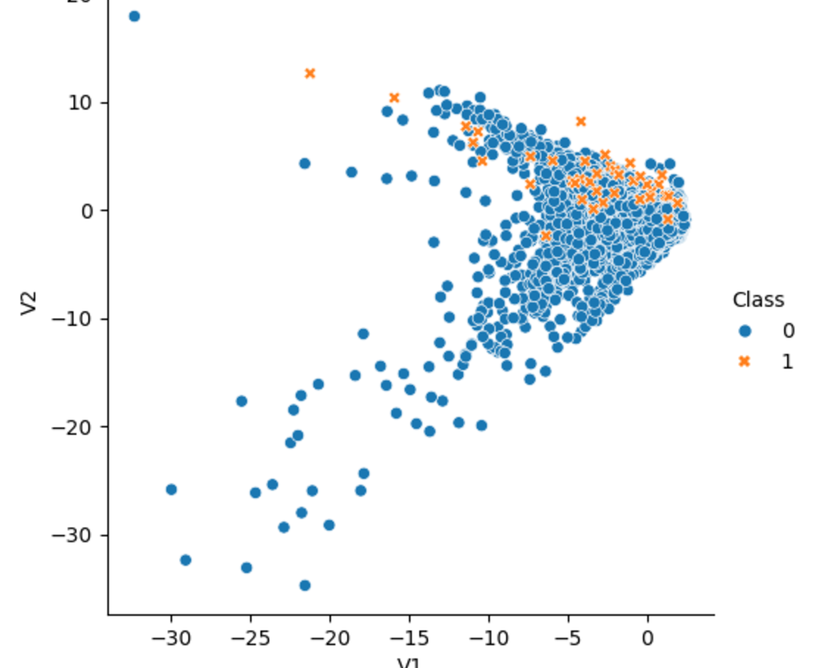
Imbalanced Data
Imbalanced Data
DABN14-Project 1
The first two principal components plotted with 10% of the data, with “class 1” (fraud) plotted above “class 0” (legitimate).
Problems:
Training (Dastidar 2024, Lucas & Jurgovsky 2020)
Evaluation (Saito & Rhemsmeier 2015)
Accuracy & AUC not good enough
Solution:
SMOTE for training (Chawla et. al 2002)
AUPRC, F_{β}-score for evaluation (Saito & Rehmsmeier 2015; Lindholm et. al 2022 (draft))

Slide 9
Agenda
DABN14-Project 1
1.
Defining the Problem
2.
Imbalanced Data
3.
Models & Theory
4.
Results
5.
Conclusion

Slide 10
Models & Theory
DABN14-Project 1
“XGBoost is widely used by data scientists to achieve state of the art results.”

Slide 11

eXtreme Gradient Boosting (XGB)
Models & Theory
DABN14-Project 1
Chen & Guestrin (2016)
Builds upon the general boosting system
Widely recognized performance in several machine learning and data mining challenges
Scaleable, multiple tweakable hyperparameters
Will be compared to a standard and simple Decision Tree model

Slide 12
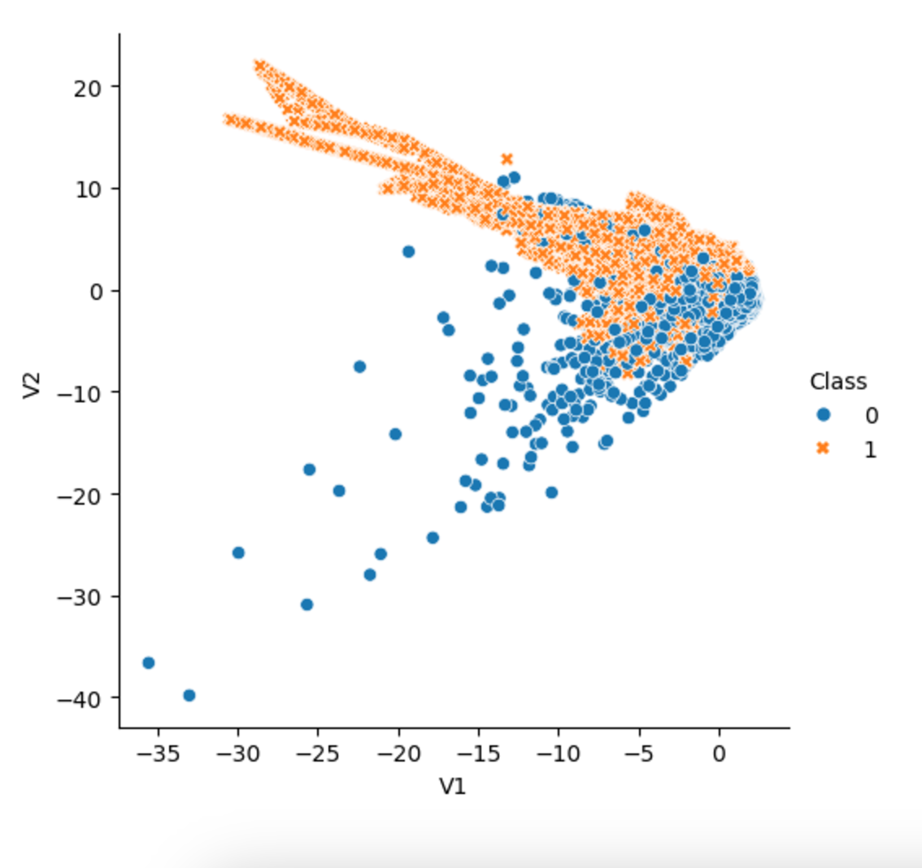
Synthetic Minority Oversampling
TechniquE (SMOTE)
Models & Theory
DABN14-Project 1
The “not majority” class was oversampled until they became equalized. The plot below shows the result of oversampling on the first two principal components using 10% of the data.
Synthetically create a new datapoint based on one of K=5 Nearest Neighbours
Chawla et. al (2002)

Slide 13
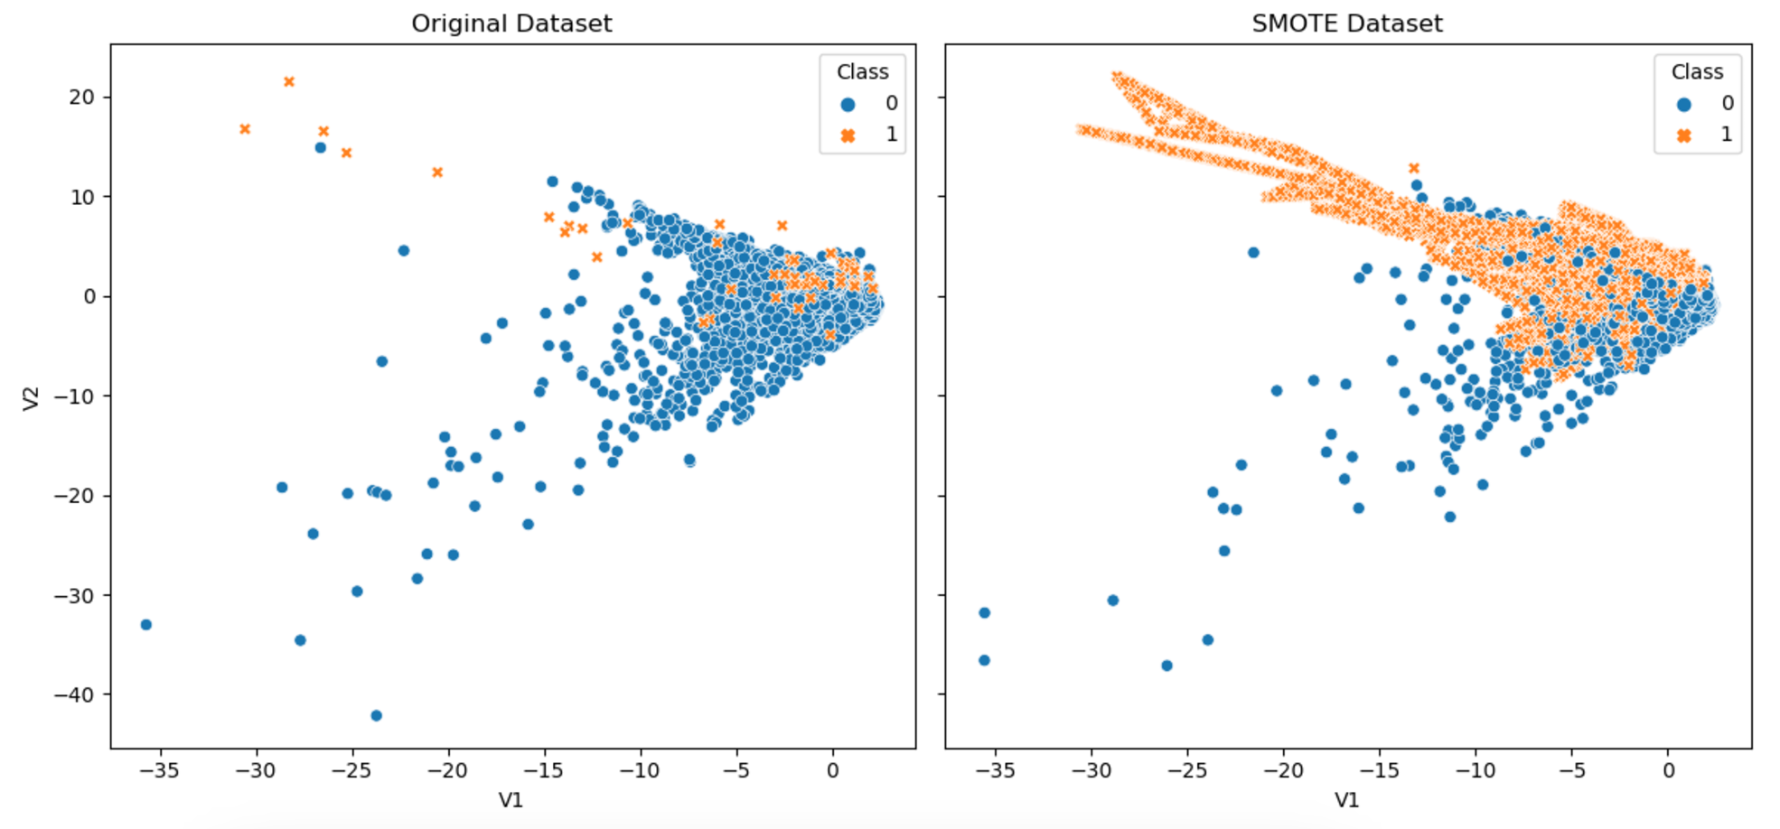
Models & Theory
DABN14-Project 1
Note: The 10% of the data shown is randomly chosen and thus differs slightly in the plots

Slide 14
Agenda
DABN14-Project 1
1.
Introduction, Data & Research Question
2.
Imbalanced Data
3.
Models & Theory
4.
Results
5.
Conclusion

Slide 15
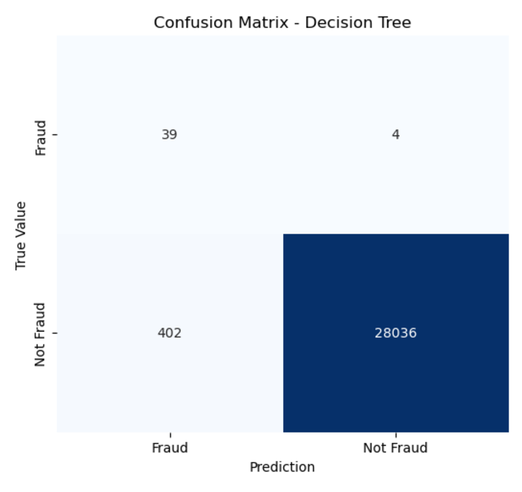
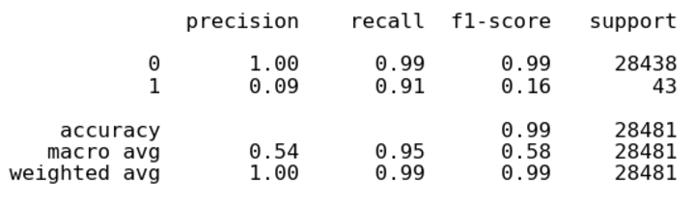
Confusion Matrix - DT
Results (Confusion Matrices)
DABN14-Project 1
Highlights:
Accuracy: 99% For class 1
Precision: 0.09
Recall: 0.91
F₁-score: 0.16

Slide 16
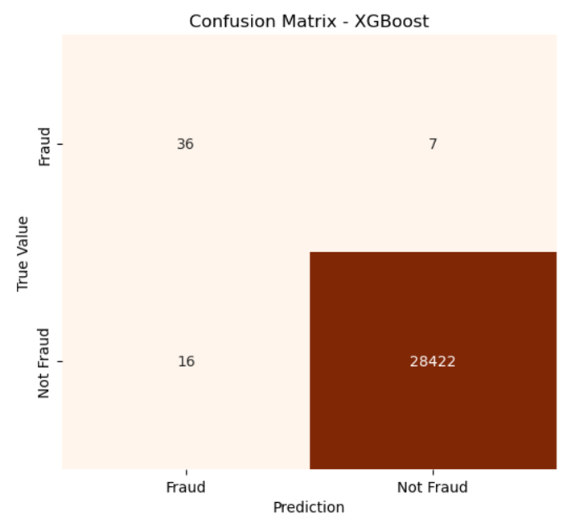
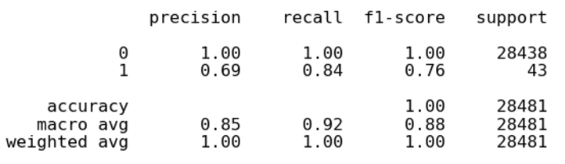
Confusion Matrix - XGB
Results (Confusion Matrices)
DABN14-Project 1
Highlights:
Accuracy: 100% For class 1
Precision: 0.69
Recall: 0.84
F₁-score: 0.76

Slide 17
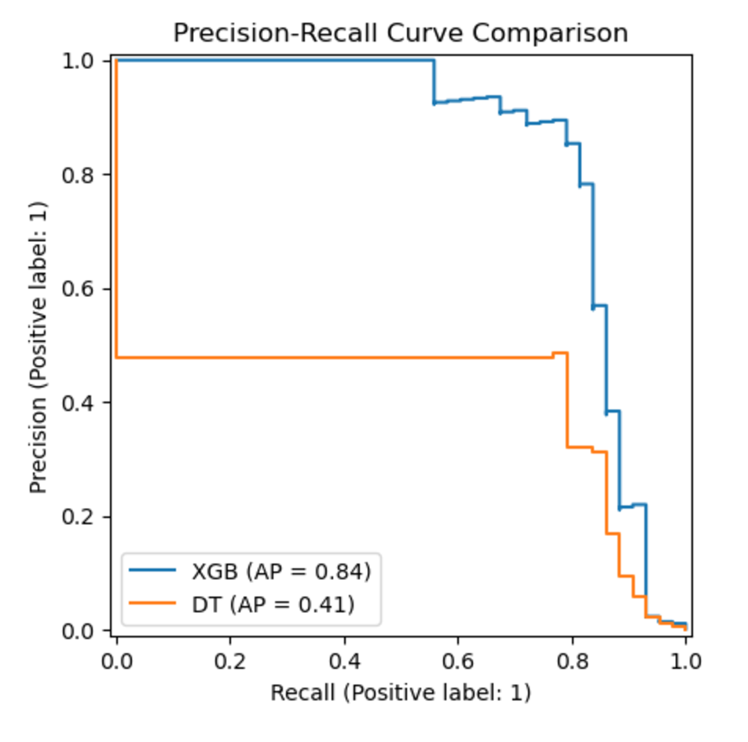
Precision-Recall curve
Results (PR-Curve)
DABN14-Project 1
Plots Precision and Recall across all hypothetical decision thresholds
AUPRC ≈ AP
XGB AP = 0.84
DT AP = 0.41
XGB model outperformed the Decision Tree model

Slide 18
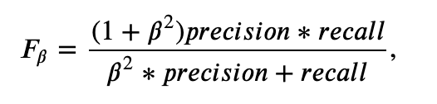
F_{β}-score
Decision Tree
XGBoost
Results (F_{β}-score)
DABN14-Project 1
0.8
0.7
0.6
0.5
0.4
Where β = 2, meaning that we value Recall twice as high as Precision
DT model F₂- score: 0.318
XGB model F₂- score: 0.804
0.3
0.2
0.1
Model F₂-score

Slide 19
Agenda
DABN14-Project 1
1.
Introduction, Data & Research Question
2.
Imbalanced Data
3.
Models & Theory
4.
Results
5.
Conclusion

Slide 20
Conclusion
Conclusion
DABN14-Project 1
Meaningful performance
Accuracy is high with both models
Imbalanced data requires special consideration
Training
Evaluation
XGB model superior because it balances Precision and Recall while still prioritising Recall

